Slide 1

CNENGR506
Intelligent System Control

Slide 2

Exercise
Write down the Transfer Function form of the following model, which has a sampling rate of 5 s
What is the order of the model? And the time delay in seconds?
^{y}k ^{= −a}1 ^{y}k −1 ^{− a}2 ^{y}k −2 ^{+ b}5^{u}k −5 ^{+ b}6^{u}k −6

Slide 3

Solution
Transfer Function form:
−5
−6
b₅ z + b₆ z
y =
u
k
−1
−2
k
1+ a₁z + a₂ z
System is 2nd order (denominator polynomial order)
Time delay is 5 samples or (using the 5 second sampling period) 25 seconds

Slide 4

0.65z⁻²
Exercise
y(k ) =
₋₁ u(k )
1− 0.91z
Control model for temperature in a greenhouse, where the input is the position of a hot water heating valve
(0 to 1), the temperature is degrees Celsius above the baseline and the sampling rate = 5 minutes
Determine the unit step response for k=1 to k=10, when the step occurs at k=3, and the initial conditions are zero
Determine the steady state gain, time constant and time delay of the system, relate these to the step response found above and check everything makes physical sense

Slide 5
Solutions
• Response: 0, 0, 0, 0, 0.65, 1.24, 1.78, 2.27, 2.72, 3.12
Steady state gain: 7.22
Time constant: 10.6 samples or 53 minutes. Note that 63% of 7.22 is 4.55 degrees.
Time delay = 2 samples = 10 minutes
Note that at full power, steady state temperature is 7.22 C above baseline, hence say laboratory temperature is 20 C, then the heated temperature in the chamber is 27.22 C which is reasonable

Slide 6
Exercise
What is the stability condition of the system that has the following characteristic polynomial?
1− 5z⁻¹ + 6z⁻²

Slide 7
Exercise Solution
The poles are 2 and 3
At least one pole is greater than unity (in fact, both are) and hence the system is unstable
The poles lie on the real axis of the complex plane, hence the response will exponential

Slide 8
Exercise
What is the stability condition for the difference equation below?
y(k ) = 1.7 y(k −1) − 0.8125 y(k − 2) + 3.2u(k − 5)

Slide 9
Solution
3.2z⁻⁵
y_{k} =
−2 ^{uk}
z² −1.7z + 0.8125 = 0
−1
1−1.7z + 0.8125z
>> roots([1 -1.7 0.8125])
ans =
0.8500 + 0.3000i
0.8500 - 0.3000i
>> abs(ans) ans =
0.9014
0.9014
Stable (probably oscillatory)

Slide 10
Another Example
0.4z⁻¹ − 0.1z⁻²
y(k ) = u(k )
1− z⁻¹ + 0.5z⁻²
1 − z ⁻¹ + 0.5z ⁻² = 0
z ² − z + 0.5 = 0
Poles
0.5 + /− 0.5 j
Absolute values 0.7017, 0.7017

Slide 11
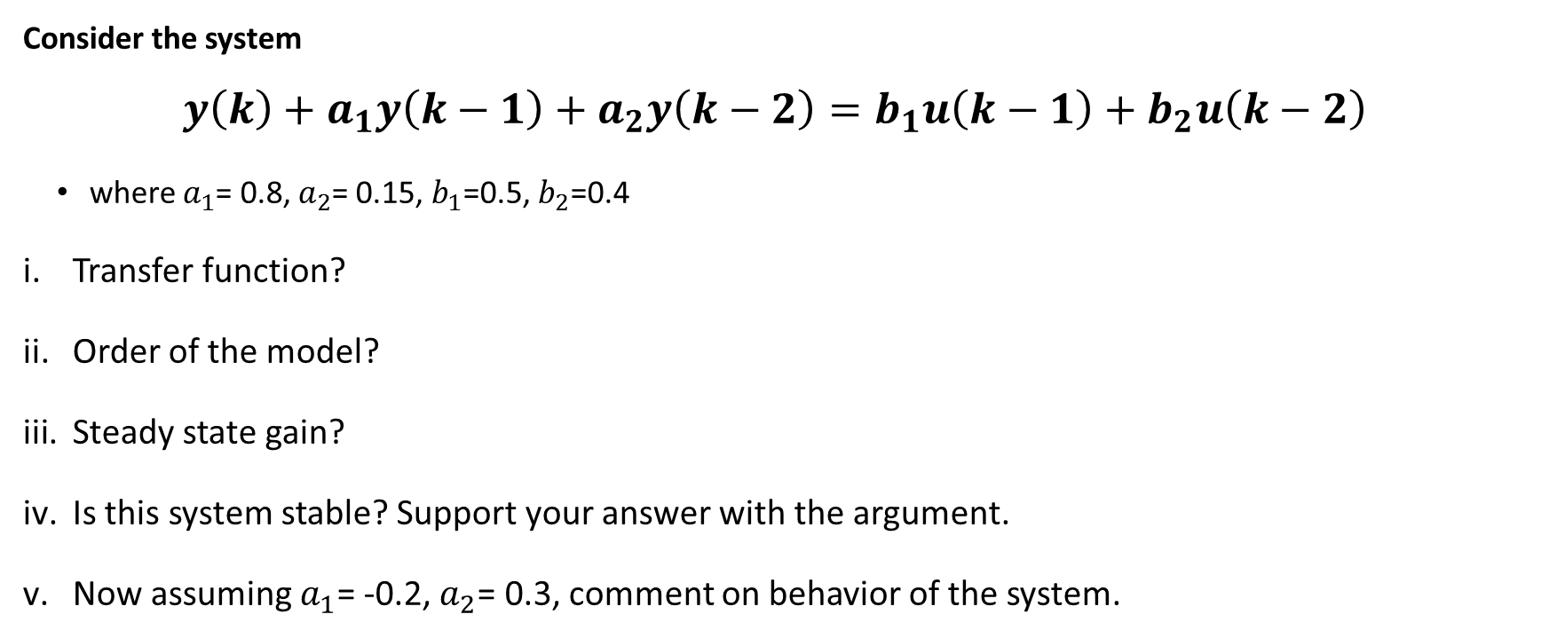
Example:
Consider the system
$$y\left(k\right)+a_{1}y\left(k−1\right)+a_{2}y\left(k−2\right)=b_{1}u\left(k−1\right)+b_{2}u\left(k−2\right)$$
where $a_{1}$= 0.8, $a_{2}$= 0.15, $b_{1}$=0.5, $b_{2}$=0.4
Transfer function?
Order of the model?
Steady state gain?
Is this system stable? Support your answer with the argument.
Now assuming $a_{1}$= -0.2, $a_{2}$= 0.3, comment on behavior of the system.

Slide 12
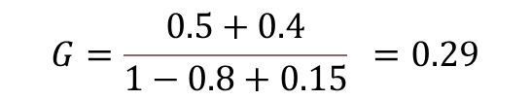

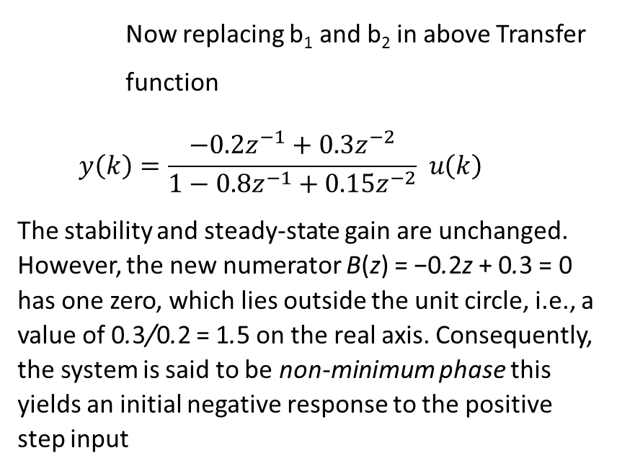
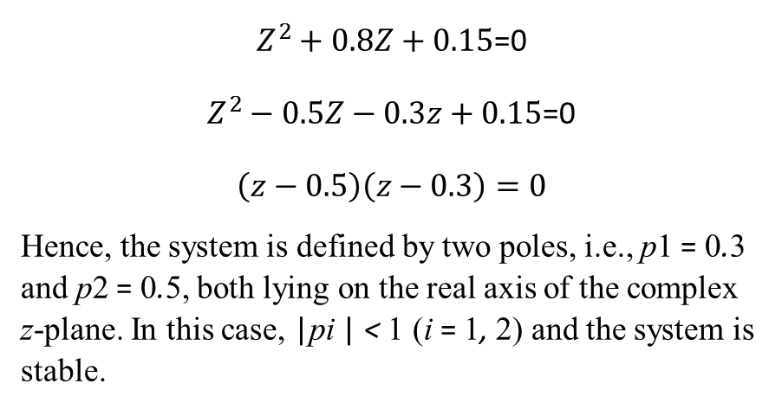
Solution
$$y\left(k\right)={\frac{0.5z^{−1}+0.4z^{−2}}{1−0.8z^{−1}+0.15z^{−2}} }_{ }u\left(k\right)$$
System is 2nd order (denominator polynomial order)
Now replacing b₁ and b₂ in above Transfer function
$$y\left(k\right)={\frac{−0.2z^{−1}+0.3z^{−2}}{1−0.8z^{−1}+0.15z^{−2}} }_{ }u\left(k\right)$$
The stability and steady-state gain are unchanged. However, the new numerator B(z) = −0.2z + 0.3 = 0 has one zero, which lies outside the unit circle, i.e., a value of 0.3/0.2 = 1.5 on the real axis. Consequently, the system is said to be non-minimum phase this yields an initial negative response to the positive step input
$$G={\frac{0.5+0.4}{1−0.8+0.15} }_{ }=0.29$$
$Z^{2}+0.8Z+0.15$=0
$Z^{2}−0.5Z−0.3z+0.15$=0
$$\left(z−0.5\right)\left(z−0.3\right)=0$$
Hence, the system is defined by two poles, i.e., p1 = 0.3 and p2 = 0.5, both lying on the real axis of the complex z-plane. In this case, |pi | < 1 (i = 1, 2) and the system is stable.

Slide 13

Exercise
The difference equation for the model is given as:
$$y\left(k\right)={−a}_{1}y\left(k−1\right)−a_{2}y\left(k−2\right)+b_{5}u\left(k−5\right)+b_{6}u(k−6)$$
Assuming $a_{1}$=-5, $a_{2}$= 6, what is the stability condition of the system?

Slide 14
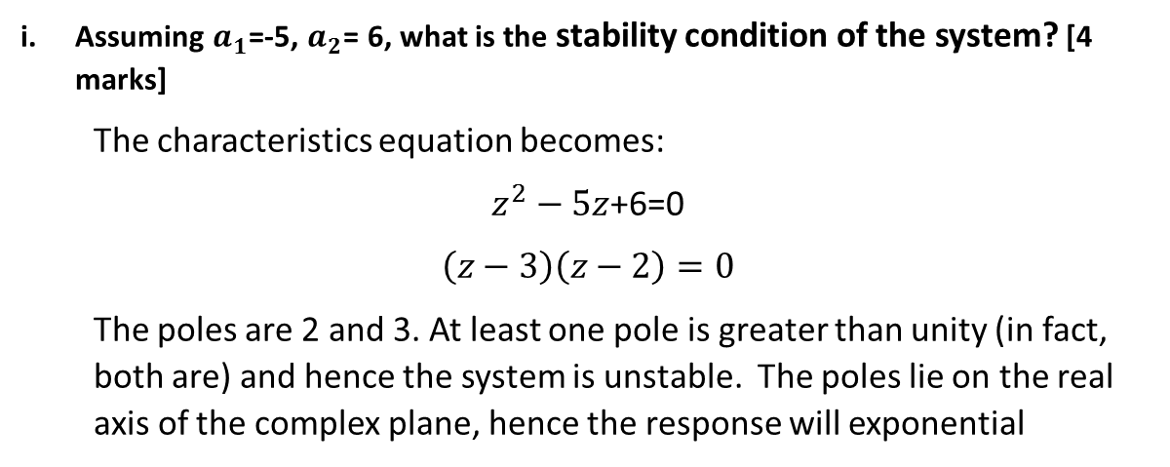
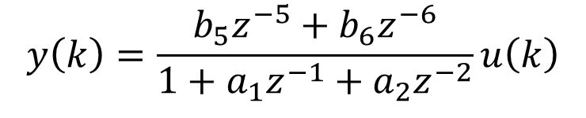
Solution
$$y\left(k\right)=\frac{b_{5}z^{−5}+b_{6}z^{−6}}{{1+a}_{1}z^{−1}+a_{2}z^{−2}}u\left(k\right)$$
Assuming $a_{1}$=-5, $a_{2}$= 6, what is the stability condition of the system? [4 marks]
The characteristics equation becomes:
$z^{2}−5z$+6=0
$$\left(z−3\right)\left(z−2\right)=0$$
The poles are 2 and 3. At least one pole is greater than unity (in fact, both are) and hence the system is unstable. The poles lie on the real axis of the complex plane, hence the response will exponential

Slide 15
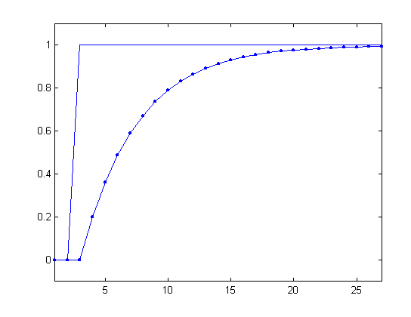
Reservoir Model Data
k | u(k ) | u(k −1) | y(k )
2 | 0 | 0 | 0
3 | 1 | 0 | 0
4 | 1 | 1 | 0.2
5 | 1 | 1 | 0.36
6 | 1 | 1 | 0.49
7 | 1 | 1 | 0.59

Slide 16
Reservoir Model Exercise
Calculate the model coefficients from the data above
These are simulated data, and the model coefficients are exactly known:
y(k) = 0.8 y(k −1) + 0.2u(k −1)
Hence this exercise is simply to demonstrate that the equation error method can give the ‘correct’ answer
Final answer is above, but you need to prove it:

Slide 17
Vector–Matrix form of the Normal Equations
ξ_{k}
u_{k}
b₁z
−1
x_{k}
y_{k}
+
1+ a₁z
−1
⎡
_{∑ y}2
−∑ y u
⎤ ⎡aˆ ⎤
⎡−∑ y y
⎤
⎢
k −1
k −1 k −1 ⎥ ⎢
1
⎥ = ⎢
k k −1
⎥
_{∑ u}2 ₁
ˆ
⎣ ^{∑ y}k^{u}k −1 ⎦
b
⎢−∑ y_{k}
−1^{u}k −1
⎥ ⎣⎢^{b}1 ⎦⎥
⎣
k − ⎦
A
aˆ
aˆ = A⁻¹b

Slide 18
Solution (1)
2
− y u
2
^{− y}k ^{y}k −1 ykuk −1
k
y_{k}
u_{k}
^{y}k −1
k −1 k −1
^{u}k −1
1 | 0 | 0 | 0 | 0 | 0 | 0 | 0
2 | 0 | 0 | 0 | 0 | 0 | 0 | 0
3 | 0 | 1 | 0 | 0 | 0 | 0 | 0
4 | 0.2 | 1 | 0 | 0 | 1 | 0 | 0.2
5 | 0.36 | 1 | 0.04 | 0.2 | 1 | -0.0720 | 0.36
6 | 0.4880 | 1 | 0.1296 | -0.36 | 1 | -0.1757 | 0.4880
7 | 0.5904 | 1 | 0.2381 | -0.4880 | 1 | -0.2881 | 0.5904
8 | 0.6723 | 1 | 0.3486 | -0.5904 | 1 | -0.3969 | 0.6723
∑ |  |  | 0.7563 | -1.6384 | 5 | -0.9327 | 2.3107

Slide 19
Solution (2)
⎡ 0.7563
⎣− 1.6384 5
− 1.6384⎤⎡aˆ⎤ ₌ ⎡− 0.9327⎤
⎢
⎥⎢ _{ˆ}⎥ ⎢
⎥
⎦⎣^{b}⎦
aˆ
⎣ 2.3107 ⎦
b
A
_{a =} ⎡aˆ⎤ ₌ ⎡4.5569 1.4932⎤⎡− 0.9327⎤
⎡− 0.8000⎤
ˆ
⎢ ⎥ ⎢ ⎥⎢
⎥ ⁼ ⎢
⎥
⎣^{bˆ}⎦
⎣1.4932 0.6893⎦⎣ 2.3107 ⎦ ⎣ 0.2000 ⎦
_{A}−1
b
Correct!
MALAB: inv(A)*b

